Slide 1
Poster presentations

Slide 2
A word about poster presentations
Try to keep text to a minimum because people don’t want to read tiny print off a poster that goes on forever. This kind of poster presentation is visually uninteresting and even worse, it makes people strain their tiny little eyeballs while they are trying to read every single word written on your poster. Details are important but remember that there are only so many details someone can absorb when they are looking at your poster plus twenty other posters. Go for visual impact, a nice big HOOK, and then, once you have drawn people in, hit them with your fancy facts!
What is a hook, you say? It is an interesting idea or visual that delivers the WOW and makes people want to stick around and find out more. Your research may be important and fascinating but if it just a huge collection of words it is unlikely people will take the time to read them all. If people want to see a lot of print they will pick up a book. Who knows, maybe they will read Harry Potter instead of your poster, but they won’t be reading Harry Potter standing in front of it. They will be sitting in a comfortable chair with a glass of wine or a beer or a margarita or a cup of tea or coffee and they will have their feet up and maybe some fuzzy slippers on and they will be relaxed and have all the time in the world to really absorb the language and the imaginative world that is Harry Potter. Your poster, I am sorry to say, is not Harry Potter.

Slide 3
You want to be visually interesting, but not unprofessional
Hi! I’m Mr. Monkey and I’m here to talk to you about NONVERBAL COMMUNICATION!

Slide 4
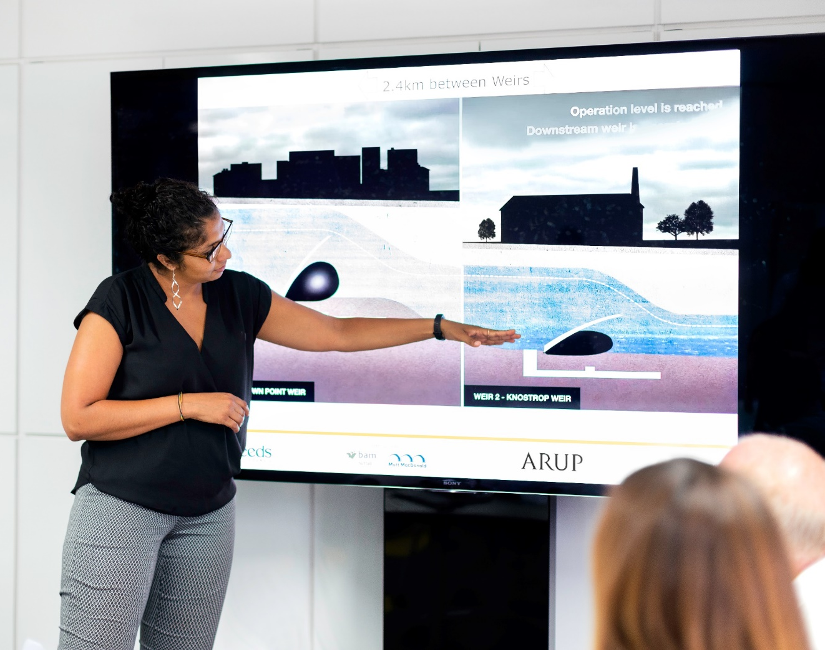
Tips:
One font
One color palette
Strike a balance between text and visuals
Step back
Take a picture!

Slide 5
Copyright-free images are available at: - unsplash.com - pixabay.com

Slide 6
“He Said, She Heard”: Gender Differences in Nonverbal Communication
Women are more expressive nonverbally:
“Women more often smiled, laughed, frowned, and expressed surprise than the men in the study” (Anderson, 1997, p. 24)
Women watch for nonverbal cues more than men do:
“Women looked at their partners for a significantly longer amount of time as compared to men” (Weisfeld & Stack, 2002, p. 8)
Men may simply be repressing nonverbal communication
“Men tend to place greater importance on words than on gestures and facial language” (Bean & Rone, 2011, p. 19)
67% of women believe they are better at reading nonverbal cues
75% of men believe they are
Who is wrong?

Slide 7
Answer: Yes, the Writing Center can give you some feedback on your posters! Other questions?

